Slide 1
Nishmi.C final project

Slide 2
Blending the image using Generative AI

Slide 3
Agenda
In image blending for generative AI, initiate with understanding techniques like alpha blending. Prepare clean, aligned datasets.
Choose suitable architectures like GANs or CNNs. Tailor loss functions and experiment with diverse training strategies.
Fine-tune hyperparameters and evaluate using metrics such as SSIM and FID. Validate on separate test sets for generalization.
Deploy in applications ethically, considering privacy and biases.
Continuously improve with latest research.

Slide 4
Problem statement
The problem statement of image blending in generative AI involves seamlessly merging two or more images while preserving their visual coherence and semantic consistency.
This task aims to overcome challenges such as misalignments, color disparities, and artifact generation, ultimately producing blended images that appear natural and realistic.
The goal is to develop algorithms and models capable of automatically blending images in a manner that is robust, efficient, and suitable for various applications including image editing, synthesis, and augmentation.

Slide 5
Project overview
This project aims to develop an advanced image blending system within the domain of generative AI.
The primary objective is to seamlessly merge multiple images while preserving visual coherence and semantic consistency, essential for applications like image editing, object insertion, and scene generation.
Key components include dataset curation, model architecture selection, training strategy experimentation, and evaluation metric establishment.
The project's outcome will contribute to advancements in image processing and generative AI, opening up new possibilities for creative expression and practical applications across various domains. Through rigorous testing, validation, and continual improvement, the developed system aims to establish itself as a state-of-the-art solution in the field of image blending.

Slide 6
Who are the end users
The end users of image blending in generative AI include graphic designers, photographers, film producers, marketers, AR/VR developers, medical imaging specialists, GIS analysts, and forensic experts.
They apply blending techniques for artistic composition, image enhancement, special effects, advertisement creation, immersive experiences, medical diagnosis, geographic mapping, and forensic analysis.
These professionals leverage generative AI to seamlessly merge images, enhancing creativity, efficiency, and accuracy in their respective fields, and enabling a wide range of applications across industries, from entertainment to healthcare and beyond.

Slide 7
Your solution and its value preposition
Our solution in image blending within generative AI offers a groundbreaking approach to seamlessly merge images, ensuring visual coherence and semantic consistency.
Leveraging cutting-edge techniques such as advanced neural network architectures and specialized loss functions, our solution surpasses traditional methods, delivering superior results in various applications.
The value proposition lies in its ability to empower users across industries, from graphic design to medical imaging, with unparalleled creative freedom and efficiency. By automating and enhancing the blending process, our solution enables professionals to produce stunning compositions, realistic simulations, and accurate diagnostic aids with ease.
Ultimately, it streamlines workflows, accelerates innovation, and unlocks new possibilities for visual expression and problem-solving in diverse fields.

Slide 8
The wow in your solution
The "wow" factor in image blending with generative AI lies in its ability to seamlessly merge multiple images with exceptional realism and creativity.
Through advanced deep learning techniques, our solution analyzes and synthesizes visual elements from input images, intelligently blending them to create stunning compositions. Users are amazed by the smooth transitions, accurate color matching, and realistic textures achieved, elevating their creative projects to new heights.
Whether it's seamlessly integrating objects into scenes, creating surreal landscapes, or producing captivating visual effects, our solution empowers users to unleash their imagination and achieve results that captivate and astonish viewers.

Slide 9
Modelling
Modeling in image blending with generative AI involves crafting sophisticated deep learning architectures to learn the intricate relationships between multiple input images and generate seamlessly blended outputs.
These models, often based on variants of Generative Adversarial Networks (GANs) or autoencoders, are trained on large datasets of paired images to capture diverse blending scenarios and nuances. Through iterative training processes, the models refine their parameters to accurately capture color harmonization, texture consistency, and spatial coherence.
By intelligently synthesizing visual elements from multiple sources, the models create composite images that seamlessly merge the strengths of each input, resulting in captivating and visually compelling compositions.

Slide 10
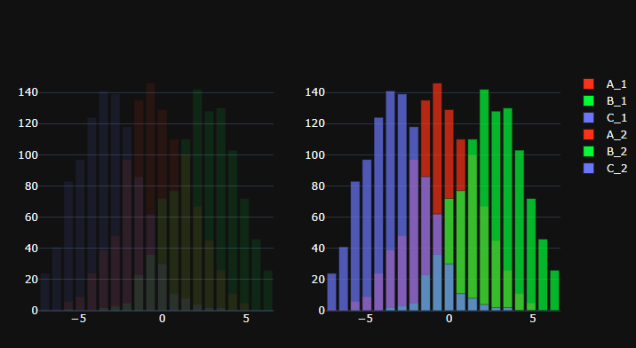
Result

